Slide 1
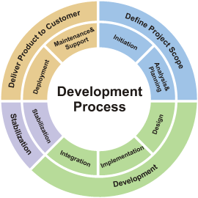
Software Development Models
Methodologies for Organizing the Software Development Process
Software Quality Assurance
Telerik Software Academy
http://academy.telerik.com

Slide 2


The Lectors
Snejina Lazarova
Project Manager
BI & Reporting Team
Dimo Mitev
QA Architect
Backend Services Team

Slide 3

Table of Contents
Software Development Models
The Waterfall Development Process
V-model (Sequential Development Model)
Iterative-incremental Development Models
Agile Development
Extreme Programing
Test Driven Development
Scrum

Slide 4
What is a Development Model?
A development model (methodology) is a set of practices and procedures for organizing the software development process
A set of rules that developers have to follow
A set of conventions the organization decides to follow
A systematical, engineering approach for organizing and managing software projects

Slide 5
Software Development Lifecycle Stages
Documentation of user requirements
Designing a software product
Implementing the software product
Testing the software solution
Deployment of the solution
Maintenance of the product

Slide 6



The Waterfall Development Process

Slide 7


The Waterfall Process
The waterfall development process
Software
Requirements
Software
Design
Implementation
(Coding)
Verification
(Testing)
Operation
(Maintenance)
Notes:
It’s only in testing that your design is tested against reality. At this point you always learn something about your design (usually that it is wrong!), and that tells you something about your requirements (ditto!)

Slide 8

The Waterfall Model
The first fundamental model was the Waterfall model
Impressively simple and very well known
Only when one development level is completed will be initiated the next one
Only between adjacent levels are there feedback loops and revisions of the previous level
Emphasis is on documentation
Testing is understood as a "one time" action at the end of the development

Slide 9
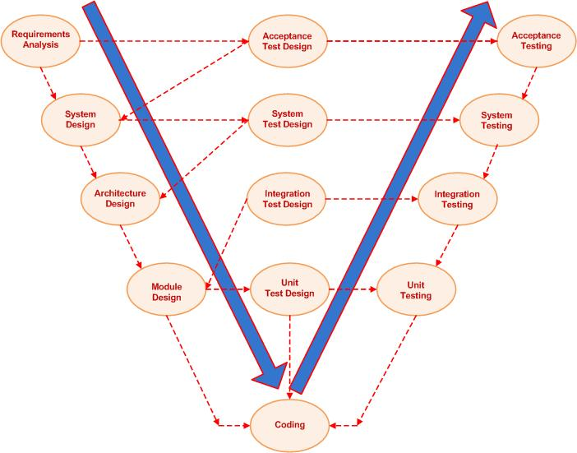
V-model
(Sequential Development Model)

Slide 10
The General V-model
The model presents two branches
Development tasks
The process of design and implementation
Testing tasks
Verification and integration into bigger subsystems
Both are corresponding activities of equal importance

Slide 11
The V-model Scheme
Requirements
definition
Acceptance
test
Functional
system design
System
test
Technical system
design
Integration
test
Component
design
Component
test
Implementation &
Integration
Programming
Verification &
Validation

Slide 12
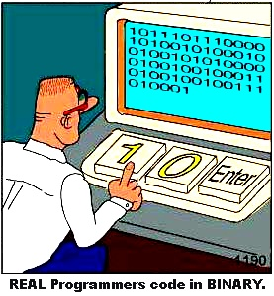
Development Tasks
Requirements specification
Specifying customer requirements
Defining the system’s purpose, characteristics and features
Functional system design
Mapping functions and dialogues of the new system

Slide 13

Development Tasks (2)
Technical system design
Designing the implementation of the system
Defining interfaces to the system environment
Decomposing the system into smaller understandable subsystems
System architecture

Slide 14

Development Tasks (3)
Component specification
Defining each subsystem
Task, behavior, inner structure, interfaces
Programming
Implementing each specified component in a programming language
Modules, units, classes

Slide 15

Testing Tasks
Component (unit) test
Verifies each software component
Does it perform correctly
According to its specification
Integration test
Checks groups of components
Do they collaborate correctly
According to the technical system design

Slide 16


Testing Tasks (2)
System test
Verifies the system as a whole
Does it meet the specified system requirements
Acceptance test
Does the system meet the customer requirements

Slide 17

Levels of Abstraction
Testing follows the levels of abstraction of development
The easiest way to find mistakes
Look for them on the same level of abstraction
On which they are produced
Testing is performed in parallel with development

Slide 18

Validation and Verification
Are we building the right system?
Does the product (or a part of it) solve its task?
Is this product suitable for its intended use?
Are we building the system right?
Does the product meet its specification?
Has it been achieved correctly and completely

Slide 19
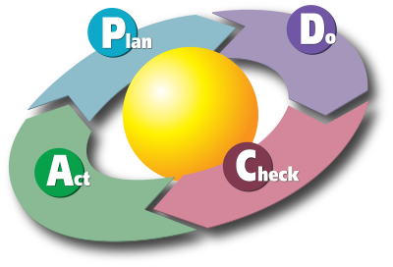
Iterative-incremental Development Models

Slide 20
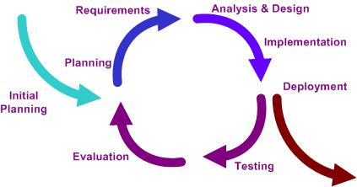
Iterative and Incremental Development
The basic idea behind these methods:
Develop a system through repeated cycles (iterative)
Smaller portions at a time/cycle (incremental)
Learn during development of previous parts or versions of the system
Plan-do-check-act cycle

Slide 21

Advantages
Produces business value early in the development life cycle
Verification and validation
Can be carried out on each increment
Take advantage of what was learnt
Product update at each iteration

Slide 22

Disadvantages
Tempts you to start coding before you have a clear idea of what you want to do
Requires more customer involvement than the linear approaches
Partitioning the functions and features might be problematic
Regression testing
Increasingly important on
all iterations after the first one

Slide 23

Initialization Step
Creating a base version of the system
Create a product to which the user can react
Sampling of the key aspects of the problem
Solution that is simple enough to understand and implement easily

Slide 24
Iteration Step
Iteration step involves:
Design and implementation of a task from the project control list
Analysis of the current version of the system
Analysis of the structure, modularity, usability, reliability, efficiency & achievement of goals
Iteration analysis is based upon user feedback, and the program analysis facilities available

Slide 25

Project Control List
Project control list
Created to guide the iteration process
Contains a record of all tasks that need to be performed
New features to be implemented
Areas of redesign of the existing solution
Constantly revised as a result of the analysis phase

Slide 26
Iterative Development Phases
Incremental development slices the system functionality into increments (portions)
Each increment includes phases:
Inception
Identifies project scope, risks, and requirements (functional and non-functional) at a high level
Elaboration
Delivers a working architecture that mitigates the top risks and fulfills the non-functional requirements

Slide 27

Iterative Development Phases (2)
Each increment includes phases:
Construction
Incrementally fills-in the architecture with production-ready code
Transition
Delivers the system into the production operating environment

Slide 28

Iterative-incremental Models Examples
Examples for Iterative-incremental models
Agile Development
Rapid Application Development (RAD)
Rational Unified Process (RUP)

Slide 29

Agile Development
Notes:
Agile projects share certain characteristics (a backlog of work, self-organizing teams, rapid, incremental delivery of new functionality to users) that aren’t necessarily value-adding for all projects and under all circumstances.

Slide 30
What is Agile Development?
What is agile development?
A group of software development methodologies based on iterative and incremental development
Requirements and solutions evolve through collaboration between self-organizing, cross-functional teams
The new name of lightweight models
After the Agile Manifesto published in 2001

Slide 31

The Agile Manifesto
“Our highest priority is to satisfy the
customer through early and continuous
delivery of valuable software“
Manifesto for Agile

Slide 32
The Agile Manifesto
The four core values of Agile software development
Individuals and interactions
Processes and tools
over
Working software
Comprehensive documentation
over
Customer collaboration
Contract negotiation
over
Responding to change
Following a plan
over

Slide 33
Agile Manifesto Principles
Our highest priority is to satisfy the customer through early and continuous delivery of valuable software
Welcome changing requirements, even late in development. Agile processes harness change for the customer's competitive advantage
Deliver working software frequently, at intervals of between a few weeks to a few months, with a preference to the shorter timescale
Build projects around motivated individuals. Give them the environment and support they need, and trust them to get the job done
The most efficient and effective method of conveying information to and within a development team is face-to-face conversation.
Working software is the primary measure of progress

Slide 34
Agile Manifesto Principles (2)
Agile processes promote sustainable development. The sponsors, developers, and users should be able to maintain a constant pace indefinitely
Business people and developers must work together daily throughout the project.
Continuous attention to technical excellence and good design enhances agility.
Simplicity – the art of maximizing the amount of work not done – is essential
The best architectures, requirements, and designs emerge from self-organizing teams
At regular intervals, the team reflects on how to become more effective, then tunes and adjusts its behavior accordingly

Slide 35

Agile Characteristics
Tasks are being broken into small increments with minimal planning
Do not directly involve long-term planning
Iterations are short time frames (time boxes)
Typically last one to four weeks
Each iteration involves a team working through a full software development cycle
E.g. pair programming

Slide 36


Agile Characteristics (2)
Available release (with minimal bugs) at the end of each iteration
Teams are usually
Cross-functional
Self-organizing
Team members take initiative and responsibility

Slide 37
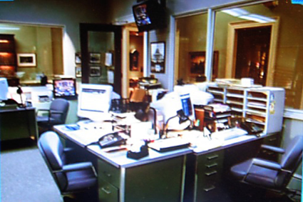
Agile Characteristics (3)
Face-to-face communication over written documents
Most agile teams work in a single open office (called a bullpen)
Team size is typically small (5-9 people)
Videoconferencing, voice, e-mail, etc. for teams not in the same location

Slide 38

Agile Characteristics (4)
Agile teams contain a customer representative
Answers mid-iteration problem-domain questions
At the end of each iteration participates in reviewing progress and re-evaluating priorities
Routine and formal daily face-to-face debrief meetings among team members

Slide 39

Agile Methodologies
eXtreme Programming (XP)
Scrum
Kanban
Lean
Crystal family of methodologies
Adaptive Software Development (ASD)
Dynamic System Development Model (DSDM)
Agile Unified Process (AUP)

Slide 40
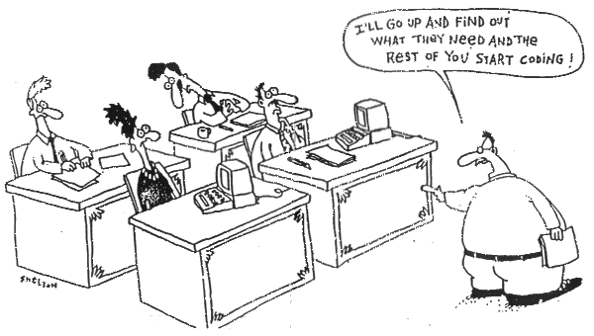
Extreme Programming

Slide 41
Extreme Programming
Extreme Programming (XP)
A type of agile software development
Intended to improve software quality and responsiveness to changing customer requirements
Advocates frequent "releases" in short development cycles (time boxes)
Intended to improve productivity
Checkpoints where new customer requirements can be adopted

Slide 42
Extreme Programming (2)
In the early 2000s, XP was the most well-know agile method
Today many of its practice have become mainstream
Many XP practices are used in most other agile methods
Sometimes explicitly, but often as a matter of course
So the relevance of known XP is as high as it was

Slide 43
XP basic values
XP's set of rules and practices is based on five fundamental ideas (called "values")
Communication
Simplicity
Feedback
Courage
Respect

Slide 44
XP basic values (2)
Communication
Many problems in projects are related to communication that failed or simply did not happen
Everyone is part of the team and communicates face to face daily
Practices that create communication:
Pair programming
Informative workspace
Frequent releases

Slide 45
XP basic values (3)
Simplicity
XP requires to always use the simplest solution that is sufficient for today's requirements
and not build something more complicated in the hope that it will be needed later
Slogan: “You Ain't Gonna Need It!“ (YAGNI)

Slide 46
XP basic values (4)
Feedback
XP integrates concrete and immediate feedback into the process wherever possible
Immediate effort estimation for each story card
Unit tests for each piece of code
Continuous integration
Short iterations and frequent releases

Slide 47
XP basic values (5)
Courage
We will tell the truth about progress and estimates
XP creates an infrastructure that allows to be courageous or even bold
in particular with automated testing and continuous integration
Respect
Everyone gives and feels the respect they deserve as a valued team member

Slide 48
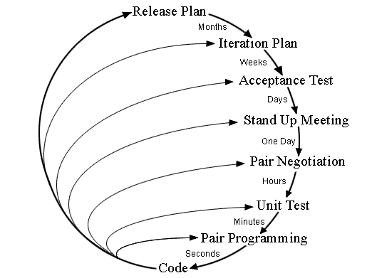
Planning / Feedback Loops
Planning and feedback loops in Extreme Programming

Slide 49
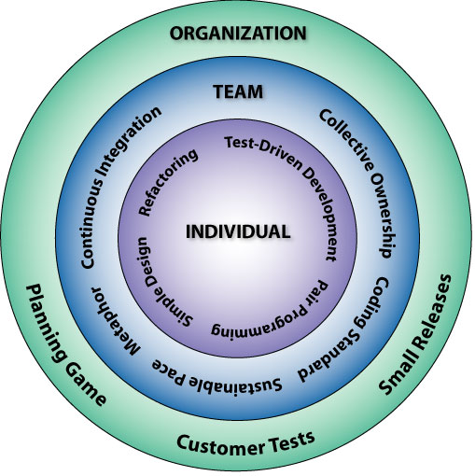
Extreme Programming: The 12 Key Practices
1. Sit Together
2. Whole Team
3. Informative Workspace
4. Energized Work
5. Pair Programming
6. Stories
7. Weekly Cycle
8. Quarterly Cycle
9. Slack
10.Ten-Minute Build
11.Continuous Integration
12.Test-First Programming
13.Incremental Design

Slide 50
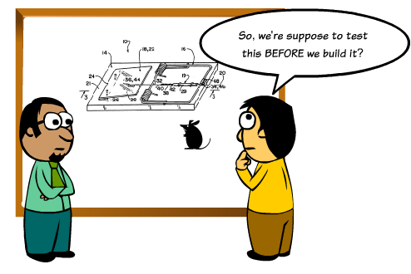
Test Driven Development
Tests First – Code Later

Slide 51

The Test Driven Development Cycle
Test-driven development (TDD) relies on the repetition of a very short cycle:
Write a failing automated test case
Defines a desired improvement or new function
Produce code to pass that test
Finally refactor the new code to acceptable standards

Slide 52
Development Cycle
Add a test
[Pass]
Run the tests
[Development
continues]
[Fail]
Write code/Refactor
[Fail]
Run the tests
[Development stops]

Slide 53
Advantages of TDD
TDD shortens the programming feedback loop
TDD provides detailed specification (tests)
TDD promotes the development of high-quality code
TDD provides concrete evidence that your software works
TDD helps to ensure that your design is clean by focusing on creation of operations that are callable and testable

Slide 54
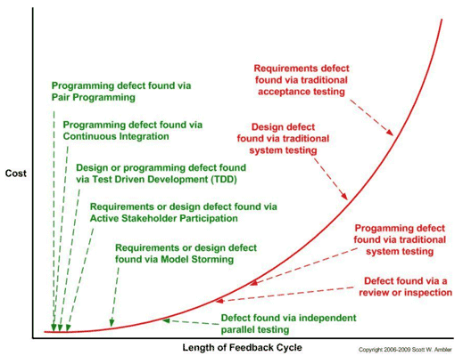
Disadvantages of TDD
Big time investment. For the simple case you lose about 20% of the actual implementation, but for complicated cases you lose much more
Additional Complexity. For complex cases your test cases are harder to write
Design Impacts. Sometimes the design is not clear at the start and evolves as you go along – this will force you to redo your test

Slide 55

Why Write the Test Before the Code?
Think through the requirement
Think about the design and usability of the API
There’s never time to write it afterwards
You write much less tests (if at all) otherwise

Slide 56
Why Make it Fail First?
Make sure the test does not have a bug
Make sure you’re testing the right thing
When the test passes, you are done
If you can’t write that test, than maybe you:
Do not understand the requirement
Have over designed things (not testable)
Do not have a small enough problem to solve

Slide 57
Why Refactor?
Constantly improve the design of the code
Remove duplication, improve readability and maintainability
You’ll need to when things change
Requirements, your understanding of them, other factors…

Slide 58
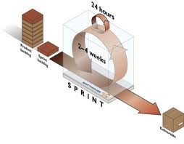
Scrum
Making Progress in Series of Sprints

Slide 59
Scrum
A framework within which people can address complex problems, and productively and creative delivery products of the highest possible value
Scrum is:
One of the agile approaches
Lightweight
Extremely simple to understand
Extremely difficult to master

Slide 60

Scrum (2)
Scrum is an iterative incremental framework for managing complex projects
An agile process that allows us to focus on delivering the highest business value in the shortest time
It allows us to rapidly and repeatedly inspect actual working software (every two weeks to one month)

Slide 61

Scrum (3)
The business sets the priorities
Teams self-organize to determine the best way to deliver the highest priority features
Every two weeks to a month anyone can see real working software
And decide to release it as is or continue to enhance it for another sprint

Slide 62
Scrum (4)
Roles
Product Owner
Development Team
Scrum Master
Artifacts
Increment
Product Backlog
Sprint Backlog
Events
Sprint
Spring Planning
Daily Scrum
Sprint Review
Retrospective

Slide 63


Pigs and Chickens
Scrum teams consist of three core roles and a range of ancillary roles
Core roles are often referred to as pigs
They are fully committed to the project
Ancillary roles are referred as chickens
No formal role and infrequent involvement
Came into being after the story The Chicken and the Pig

Slide 64
Scrum Roles
Product Owner
Development Team
Scrum Team
Scrum Master

Slide 65
Scrum Core Roles
The core roles in Scrum teams are those committed to the project in the Scrum process
They are the ones producing the product (objective of the project)
Scrum core roles:
Scrum Master – maintains the Scrum processes
Product Owner – represents the stakeholders
Team – a group of about 7 people

Slide 66
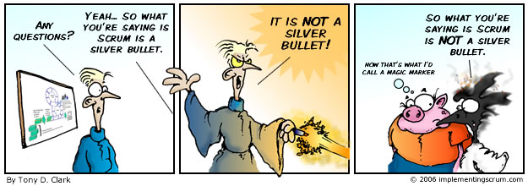
The Scrum Master
Scrum is facilitated by a Scrum Master
The Scrum Master is not the team leader
Acts as a buffer between the team and any distracting influences

Slide 67
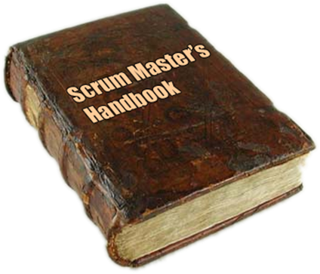

The Scrum Master (2)
Accountable for removing impediments
Enforcer of rules
Protects the team and keep them focused on the tasks in hand
Also referred to as servant-leader

Slide 68

The Team
The Team is responsible for delivering the product
Typically made up of 5–9 people
Team members have cross-functional skills
The team does the actual work
Analyze, design, develop, test, technical communication, document, etc.

Slide 69

The Team (2)
Membership should change only between sprints
It is recommended that the Team be self-organizing and self-led
Although often works with some form of project or team management

Slide 70

The Product Owner
The Product Owner represents the voice of the customer
He is accountable for ensuring that the Team delivers value to the business
Writes customer-centric items (typically user stories)
Prioritizes them, and adds them to the product backlog

Slide 71

The Product Owner (2)
Accepts or rejects work results
Scrum teams should have one Product Owner
The product owner also can be a member of the Development Team
It is not recommended this role to be combined with that of Scrum Master

Slide 72
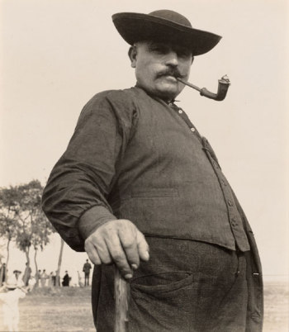
Scrum Ancillary Roles
Stakeholders (customers, vendors)
The people who enable the project
For them the project will produce the agreed-upon benefits, which justify its production
Directly involved only in the process during the sprint reviews

Slide 73

Scrum Ancillary Roles (2)
Managers (including Project Managers)
People who will set up the environment for product development
Responsible for keeping the product vision clear
Help for day-to-day problems resolving (out of Team scope)
Provide tools instead of solutions
Often the Scrum Master and the Manager are one and same person

Slide 74
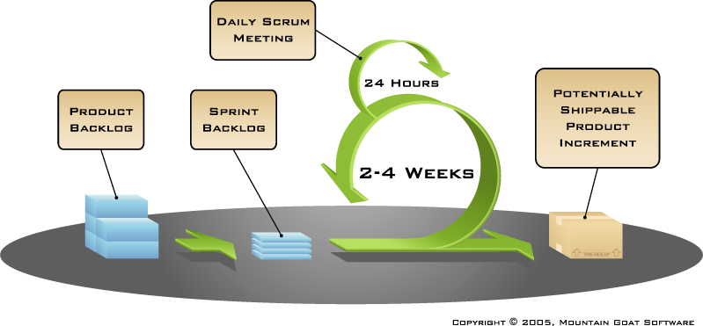
The Scrum Process Framework

Slide 75
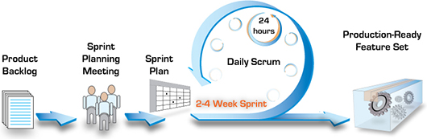
Scrum Terminology
Sprint/Iteration
An iteration in the Scrum development
Usually two to four weeks
Backlog
All features that have to be developed represented in User Story format
Burn down chart (Release and Sprint)

Slide 76

Product Backlog
A high-level list with broad descriptions of all potential features for the product (backlog items)
Maintained throughout the entire project
Prioritized by the product owner
Open and editable
In terms of years
The product backlog

Slide 77
A Sample Product Backlog
Backlog item | Estimate
Allow a guest to make a reservation | 3
As a guest, I want to cancel a reservation. | 5
As a guest, I want to change the dates of a reservation. | 3
As a hotel employee, I can run RevPAR reports (revenue-per-available-room) | 8
Improve exception handling | 8
… | 34
… | 55

Slide 78
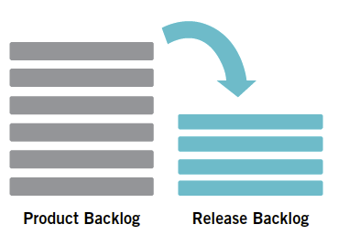
Release Backlog
Limited set of items from the Product Backlog that should be developed for a given release
Focused to specific goals identified for a specific time-frame
Reprioritized by the product owner
All items estimated at high level (story points)
In terms of months

Slide 79

Sprint Backlog
The list of work the team must address during the next sprint
Features are broken down into tasks
Between four and sixteen hours of work
Tasks on the sprint backlog are never assigned
In terms of weeks
The sprint backlog

Slide 80
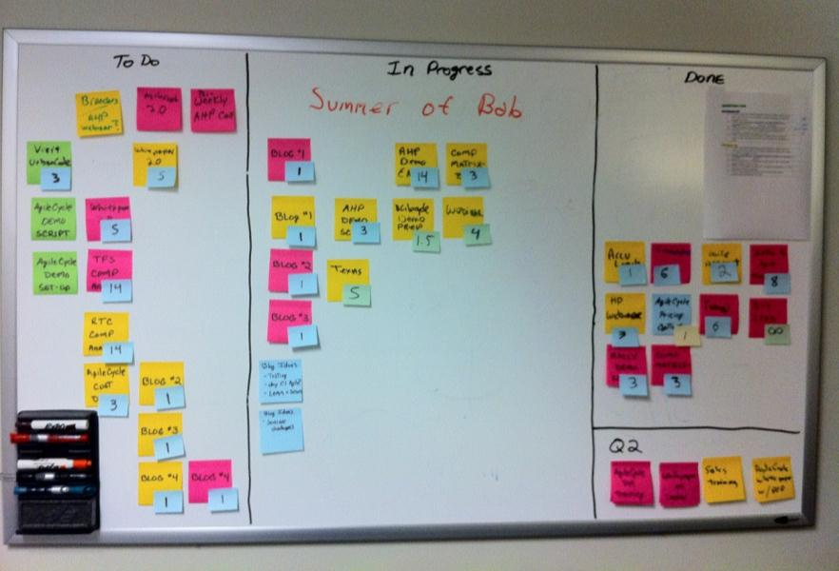
Sprint Backlog (2)
Often an accompanying task board is used to see and change the state of the tasks
Labels are used like “to do”, “in progress” and “done”

Slide 81
A Sample Sprint Backlog
Backlog item | Status | Day 1 | Day 2 | Day 3 | Day 4 | Day 5
Code the user interface | Completed | 20 | 10 | 0 | 0 | 0
Code the middle tier | Not Started | 8 | 8 | 8 | 8 | 8
Test the middle tier | In Progress | 24 | 20 | 30 | 25 | 20
Write online help | Completed | 12 | 12 | 12 | 12 | 0
Write the foo class | Completed | 12 | 0 | 0 | 0 | 0
Add error logging | Not Started | 8 | 8 | 8 | 8 | 8

Slide 82
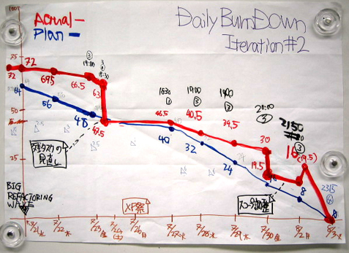
Sprint Burn Down Chart
The sprint burn down chart is a publicly displayed chart
Shows remaining work in the sprint backlog
Updated every day, it gives a simple view of the sprint progress

Slide 83
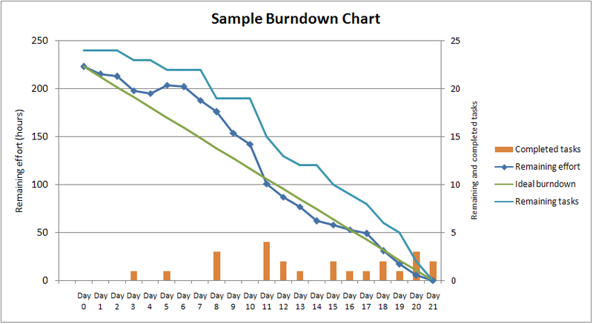
A Sample Burn Down Chart

Slide 84
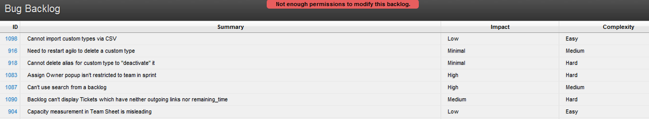
Bug Backlog
A type of backlog which includes bugs only
Can be part of the Product Backlog
Bugs are listed by their priority
Includes bugs reported by customers
Bugs are prioritized by Product Owner (may be supported by QA lead)

Slide 85

Team Backlog
Created by the Team
Represents leftover work that team should do
It’s a list of “want to do”, and not a commitment
Items can be estimated (preferable) or not
It has a single owner – the team’s Product Owner

Slide 86
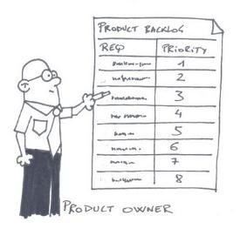
Scrum Practices
Sprint Planning Meeting
At the beginning of the sprint cycle
Establish the Sprint backlog
Daily Scrum stand-up meeting
Each day during the sprint
Timeboxed to 15 minutes
Sprint Review Meeting
Review the work completed / not completed
Sprint Retrospective

Slide 87

Sprint Planning Meeting
Held at the beginning of the sprint cycle (every 7-30 days)
Team selects items from the product backlog they can commit to completing
Sprint backlog is created
Tasks are identified and each is estimated (1-16 hours)
Done collaboratively
Not alone by the Scrum Master

Slide 88
Sprint Planning Meeting (2)
Eight hour time limit (for a 4 week Sprint)
(1st four hours) Product Owner + Team:
Dialog for prioritizing the Product Backlog
(2nd four hours) Team only:
Hashing out a plan for the Sprint, resulting in the Sprint Backlog
Code the middle tier (8 hours)
Code the user interface (4)
Write test fixtures (4)
Code the foo class (6)
Update performance tests (4)
As a vacation planner, I want to see photos of the hotels

Slide 89

The Daily Scrum
Held each day during the sprint
Also called the daily standup
This meeting has specific guidelines:
The meeting starts precisely on time
All are welcome, but normally only the core roles speak
The meeting is time-boxed to 15 minutes
The meeting should happen at the same location and same time every day

Slide 90


The Daily Scrum (2)
Everyone answers 3 questions
1
What did you do yesterday?
2
What will you do today?
3
Is anything in your way?

Slide 91
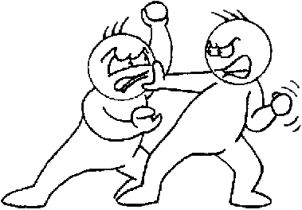
The Daily Scrum (3)
The Scrum meeting helps avoiding other unnecessary meetings
If a problem needs discussion – this can be done after the meeting

Slide 92
Sprint Review/Demo Meeting
Review the work that was completed and not completed
Present the completed work to the stakeholders (a.k.a. “the demo”)
New features or underlying architecture
Incomplete work cannot be demonstrated
2-hour preparation time rule
No slides
Typically 2.5% of Sprint Duration

Slide 93
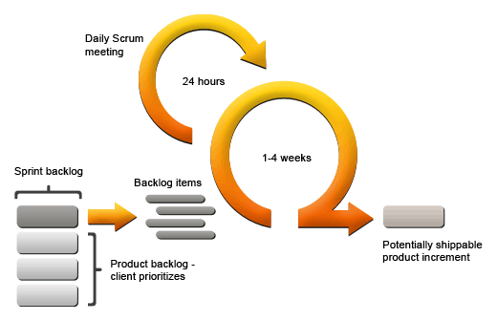
Sprint Retrospective
All team members reflect on the past sprint
Make continuous process improvements
Two main questions are asked
What went well during the sprint?
What could be improved in the next sprint?
Three hour time limit for a 4 week Sprint

Slide 94
User Story
In Agile development, user stories are written to capture requirements from the perspectives of developers, testers, and business representatives
A user story, as a written representation, has the following structure
As a [user role], (WHO)
I want to [goal], (WHAT)
so I can [reason] (WHY)

Slide 95

Estimating Software Development
Estimation is often expensive
Accuracy
Effort of Time

Slide 96
Story Points
Very common way to estimate work
Based on size, effort and complexity, not duration
Unitless and numerically relative
Different for each team of estimators
Points are additive
Based on historical reality
Easy to use and understand

Slide 97
Story Points (2)
Using Story Points
We can see right away
Which work items cost the most
Total cost of all the work
Total cost to an iteration
Product Backlog
Cost: 13
Cost: 20
Cost: 20
Cost: 3
Cost: 5
Cost: 1
Cost: 8
Cost: 13
Cost: 3
Cost: 100
Cost: 13
Defect
Requirement
Constraint

Slide 98

Planning Poker

Slide 99
Planning Poker Rules
Each estimator has a deck of estimation cards
Values similar to the Fibonacci sequence (0, 1, 2, 3, 5, 8, 13, 21, 34, 55…)
Customer/Product Owner reads a story and it’s discussed briefly
Each estimator selects a card that’s his or her estimate
Cards are turned over so all can see them (synchronously)
Discuss differences (especially outliers)
Re-estimate until estimates converge

Slide 100
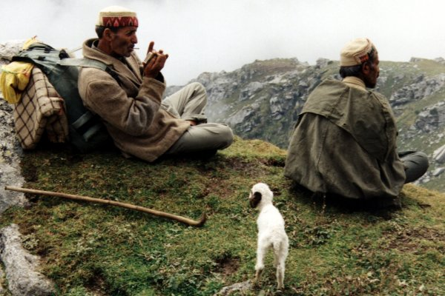
Who Uses Scrum?
Telerik
Microsoft
Yahoo
Google
Electronic Arts
Lockheed Martin
Philips
Siemens
Nokia
IBM
BBC
Etc.

Slide 101
Software Development Models
?
?
?
?
?
Questions?
?
?
?
?
?
?

Slide 102




Free Trainings @ Telerik Academy
C# Programming @ Telerik Academy
csharpfundamentals.telerik.com
Telerik Software Academy
academy.telerik.com
Telerik Academy @ Facebook
facebook.com/TelerikAcademy
Telerik Software Academy Forums
forums.academy.telerik.com

